Slide 1

Chapter yellow
SURF HPML Group
Bryan Cardenas
Lars Veefkind High Performance Machine Learning

Slide 2

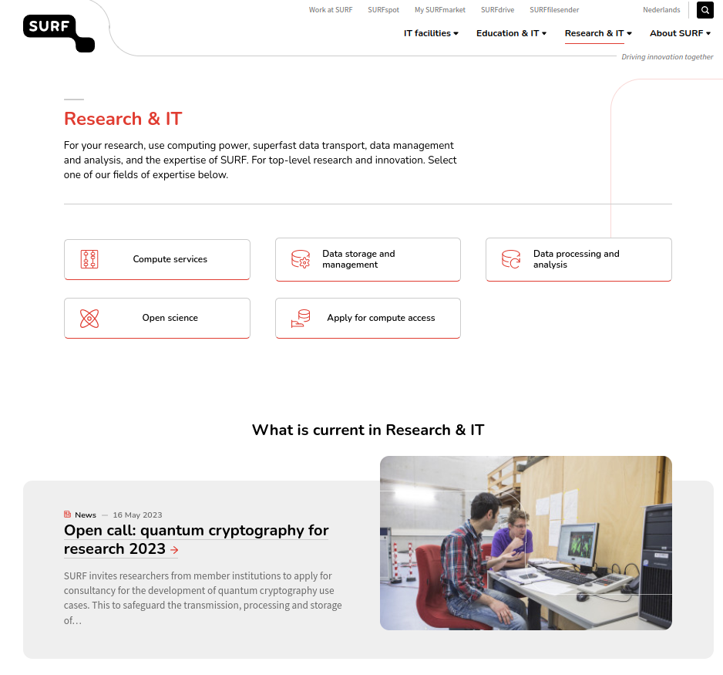
SURF is the collaborative organisation for IT in Dutch education and research

Slide 3
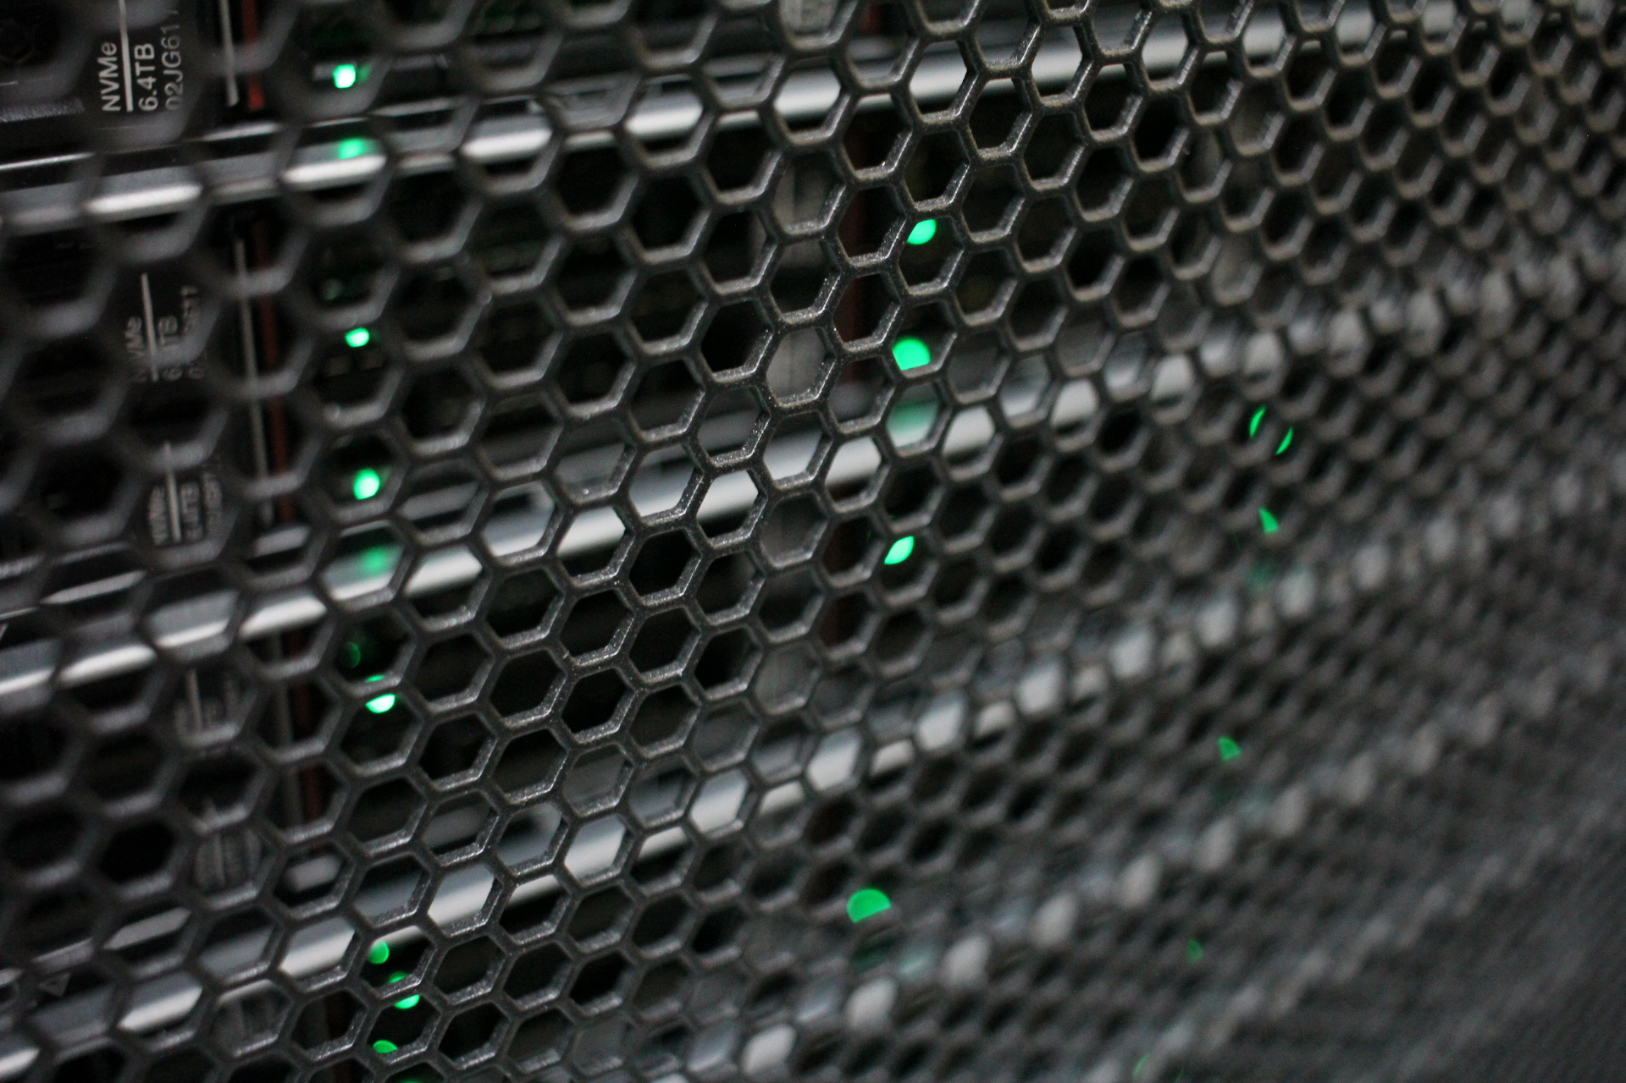
Snellius is the Dutch National supercomputer operated by SURF.
The system facilitates scientific research

Slide 4
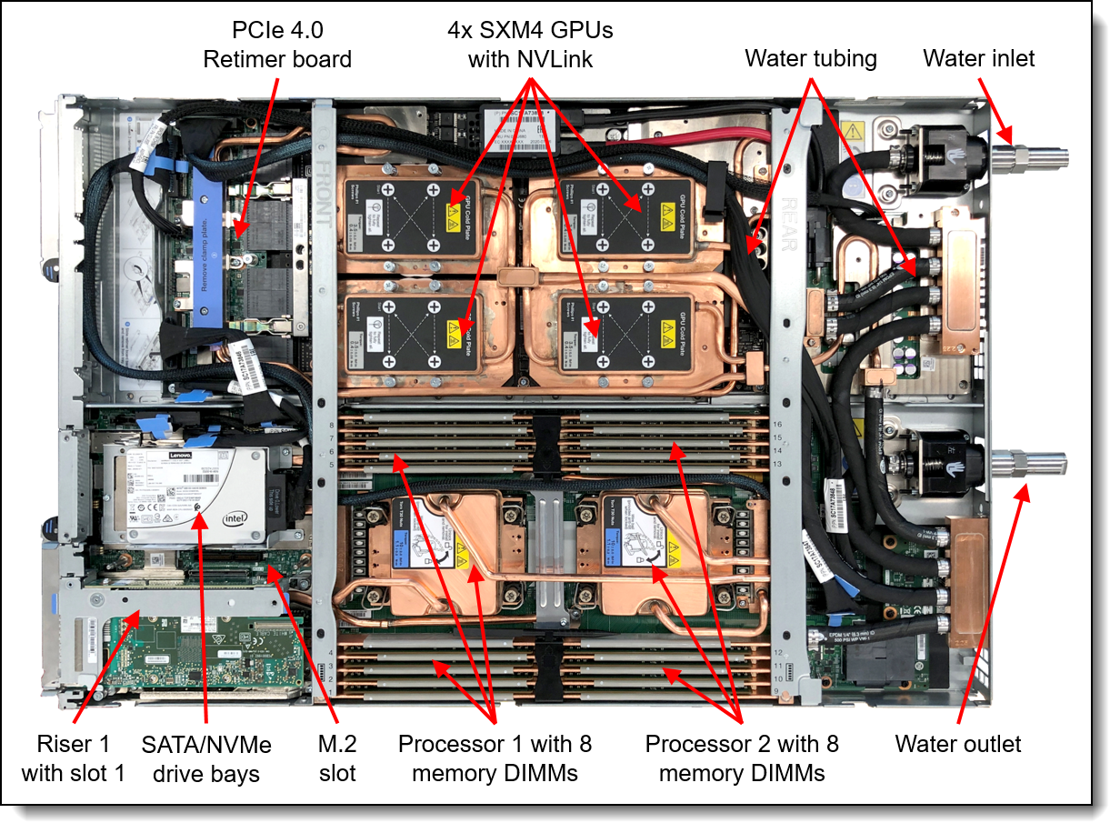
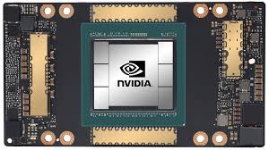
GPU Nodes
72 × 4 × NVIDIA A100 40 GB VRAM
88 x 4 x NVIDIA H100 96 GB VRAM
Snellius is the Dutch National supercomputer operated by SURF.
total peak performance will reach 30 Pflop/s (fp32)

Slide 5
GPU Nodes
72 × 4 × NVIDIA A100 40 GB VRAM
88 x 4 x NVIDIA H100 96 GB VRAM
CPU Nodes
Over 1500 CPU nodes (256G-8TB RAM).
Snellius is the Dutch National supercomputer operated by SURF.
total peak performance will reach 30 Pflop/s (fp32)

Slide 6

The system facilitates scientific research

Slide 7
The system facilitates scientific research
ML@SURF

Slide 8
The system facilitates scientific research
ML@SURF
Bridge the gap between cutting-edge AI research and adopting researchers
Improve efficiency of numerical simulations
ML expertise still very expensive and scarce
ML training scaleout is not trivial

Slide 9
The system facilitates scientific research
ML@SURF
Growing group ~15
Wide range of expertise
Bridge the gap between cutting-edge AI research and adopting researchers
Improve efficiency of numerical simulations
ML expertise still very expensive and scarce
ML training scaleout is not trivial

Slide 10
HPML@SURF
Research support and outreach
Algorithm scaling and efficiency
Algorithm design

Slide 11
HPML@SURF
Research support and outreach
Algorithm scaling and efficiency
Algorithm design
Courses, bootcamps, workshops, tutorials
SC’18 & ISC19 & ISC’20 & ISC’21 Deep Learning on Supercomputers and for science
Software stack deployment and maintenance

Slide 12
HPML@SURF
Research support and outreach
Algorithm scaling and efficiency
Algorithm design
Courses, bootcamps, workshops, tutorials
SC’18 & ISC19 & ISC’20 & ISC’21 Deep Learning on Supercomputers and for science
Software stack deployment and maintenance
Collaborations with Intel, Xilinx, AMD, Dutch Academia & Research institutions
Contributions to MKL-DNN and MLSL, Tensorflow, Caffe, Horovod

Slide 13
HPML@SURF
Research support and outreach
Algorithm scaling and efficiency
Algorithm design
Courses, bootcamps, workshops, tutorials
SC’18 & ISC19 & ISC’20 & ISC’21 Deep Learning on Supercomputers and for science
Software stack deployment and maintenance
Collaborations with Intel, Xilinx, AMD, Dutch Academia & Research institutions
Contributions to MKL-DNN and MLSL, Tensorflow, Caffe, Horovod
AI for science: all modalities
Medical AI: image analysis, NLP, digital histopathology
Quantum Machine Learning
XAI Multiscale workflow
Automatic ML architecture & pipeline discovery

Slide 14
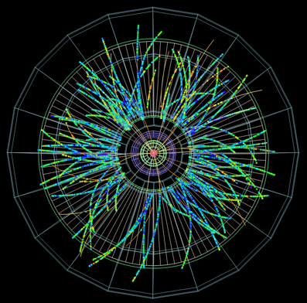
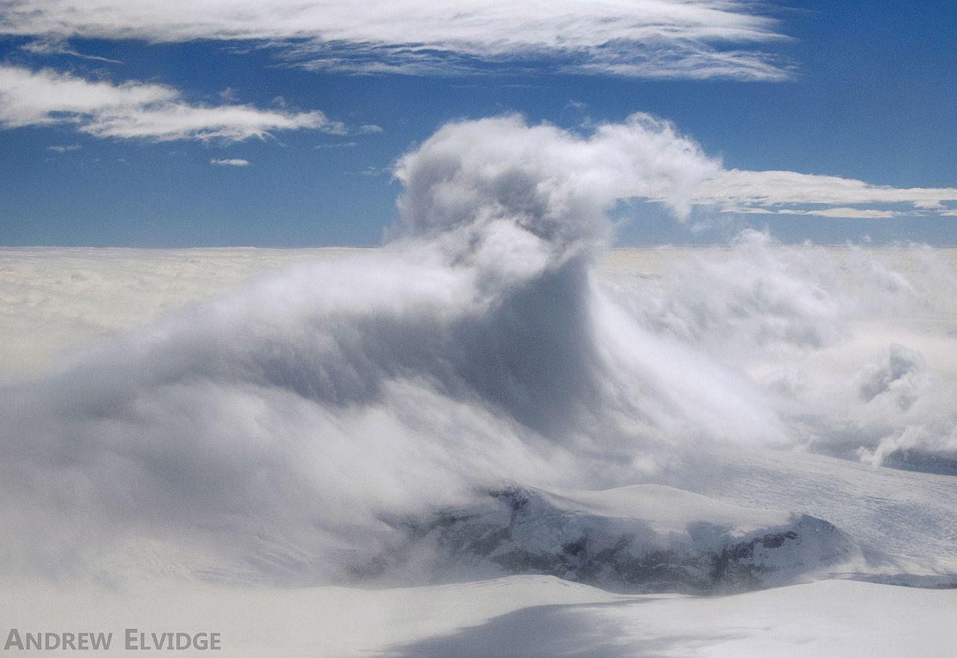
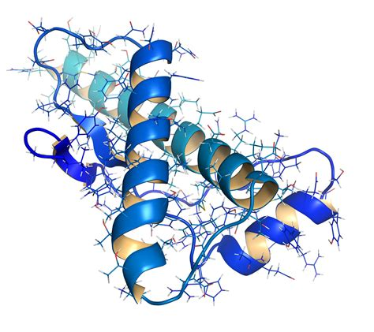
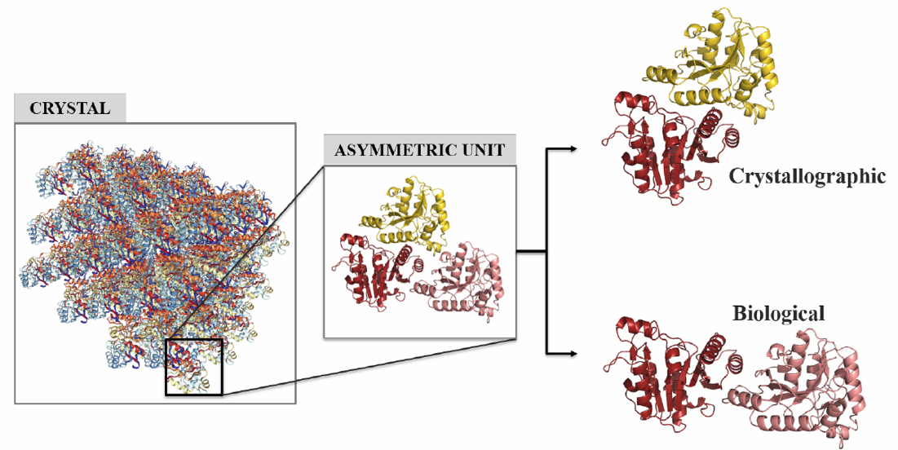
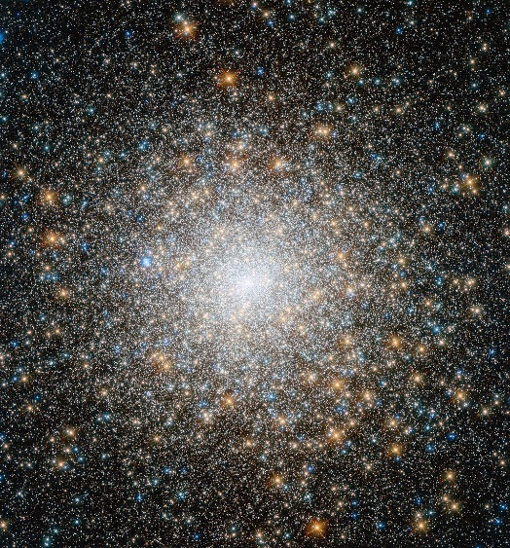
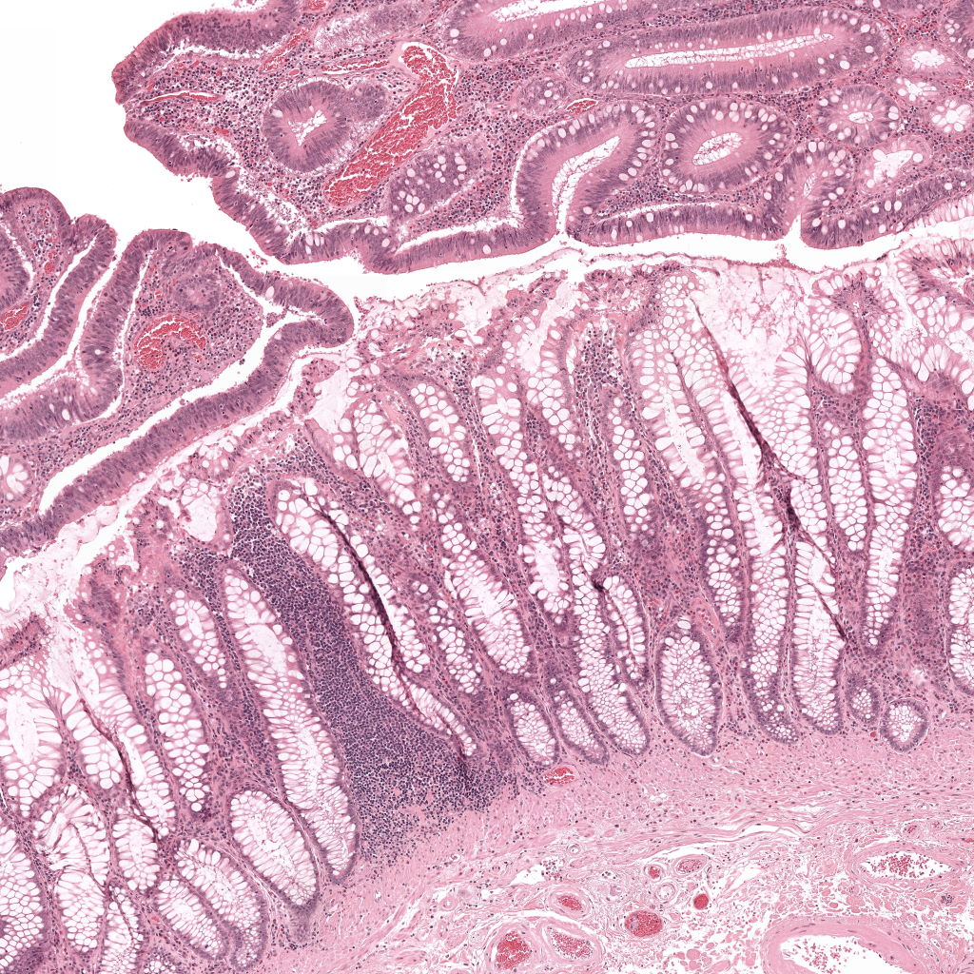
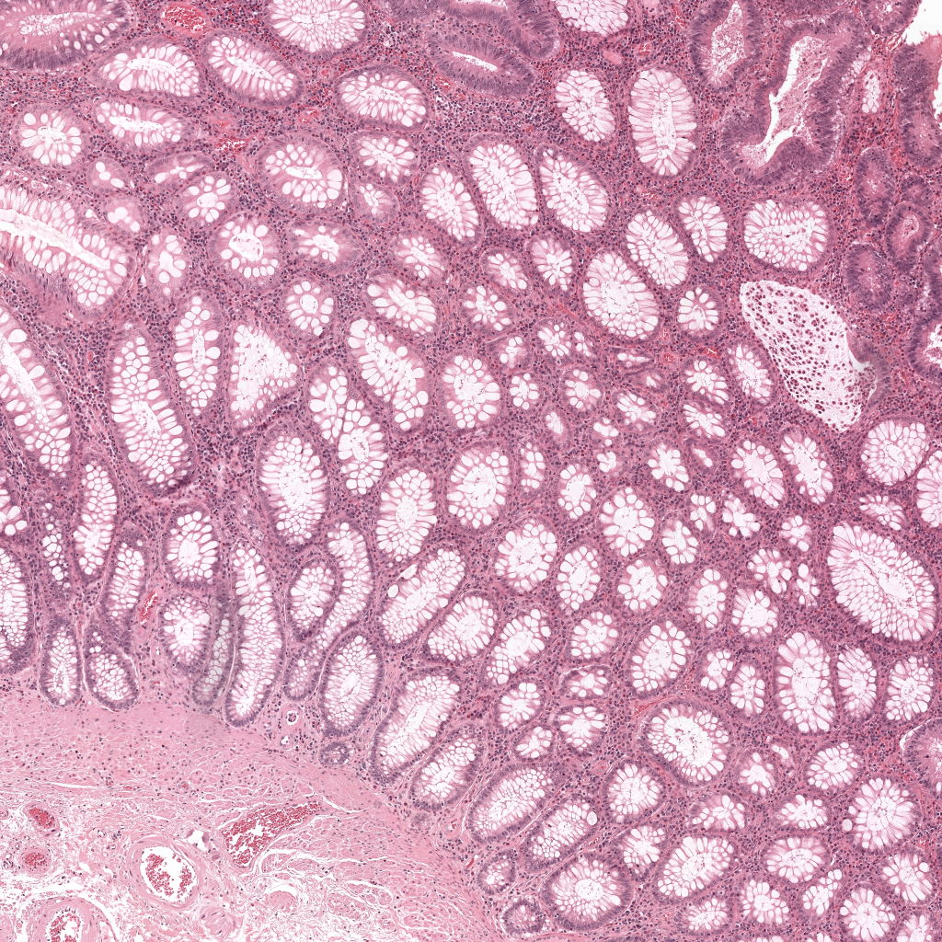
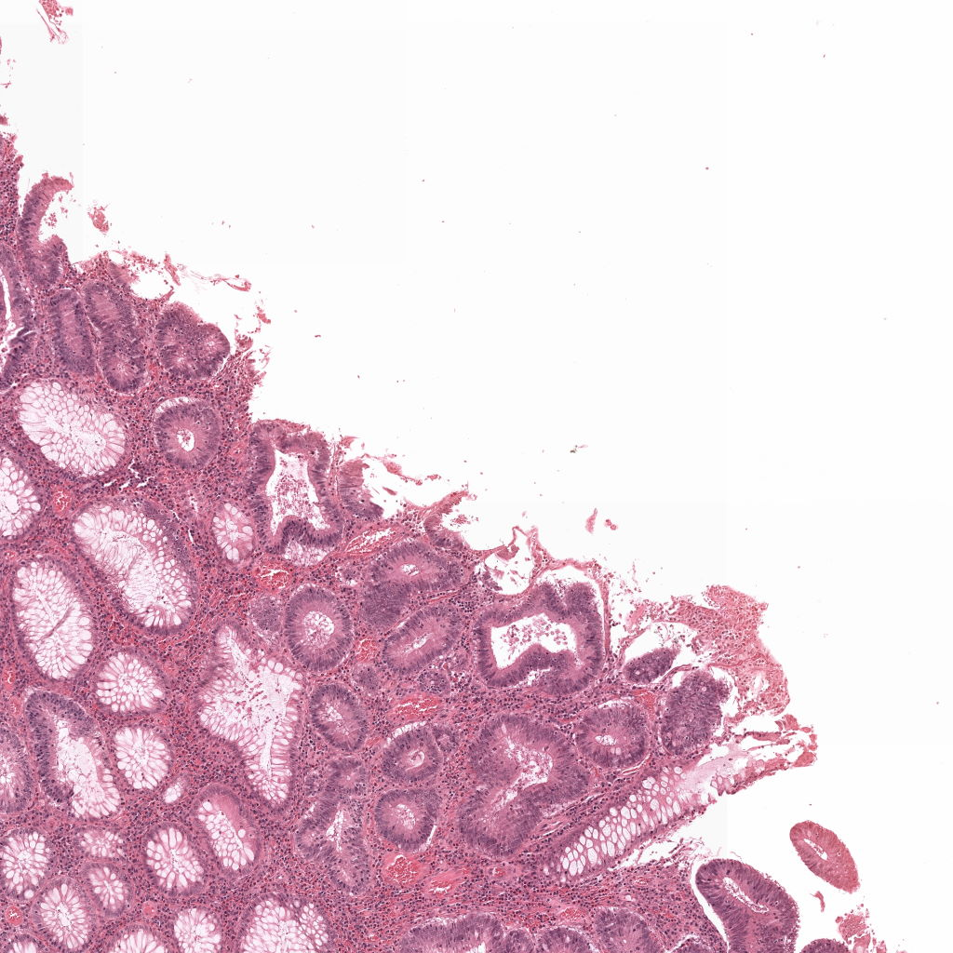
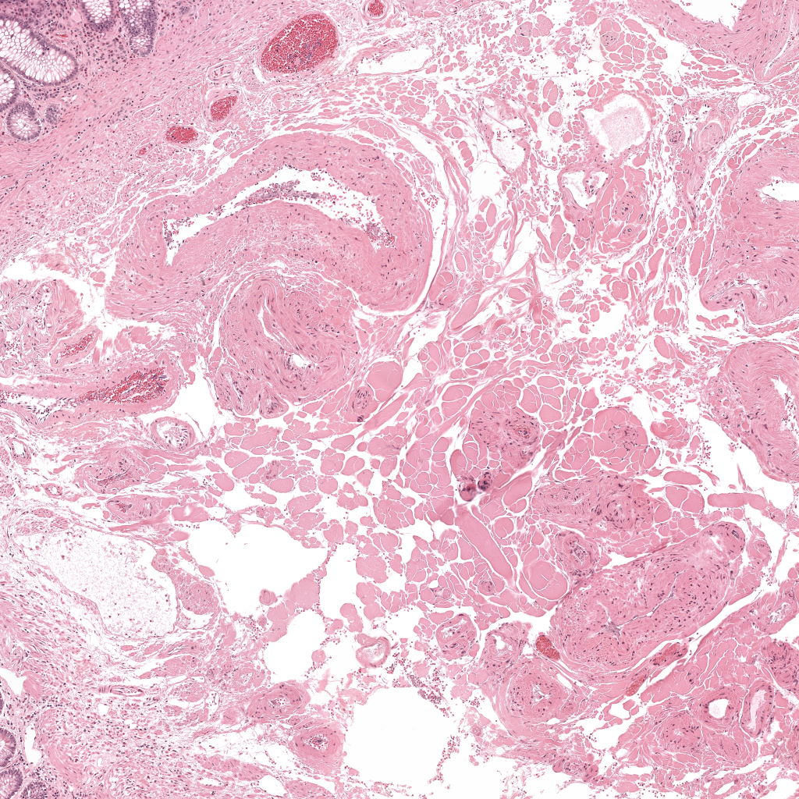
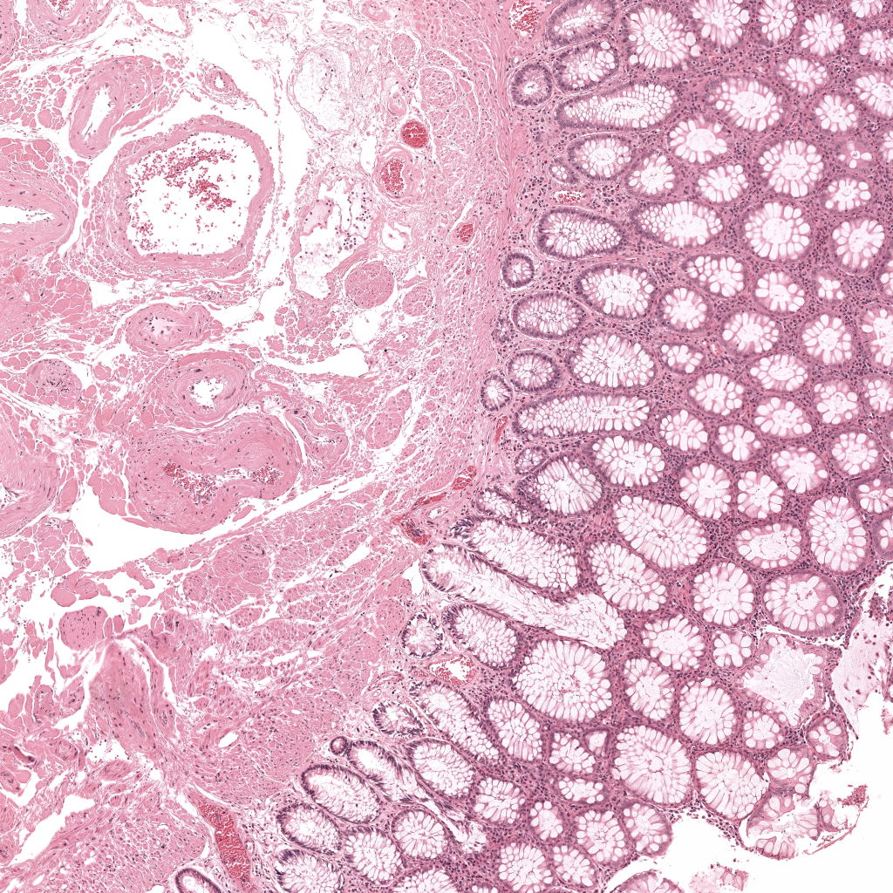
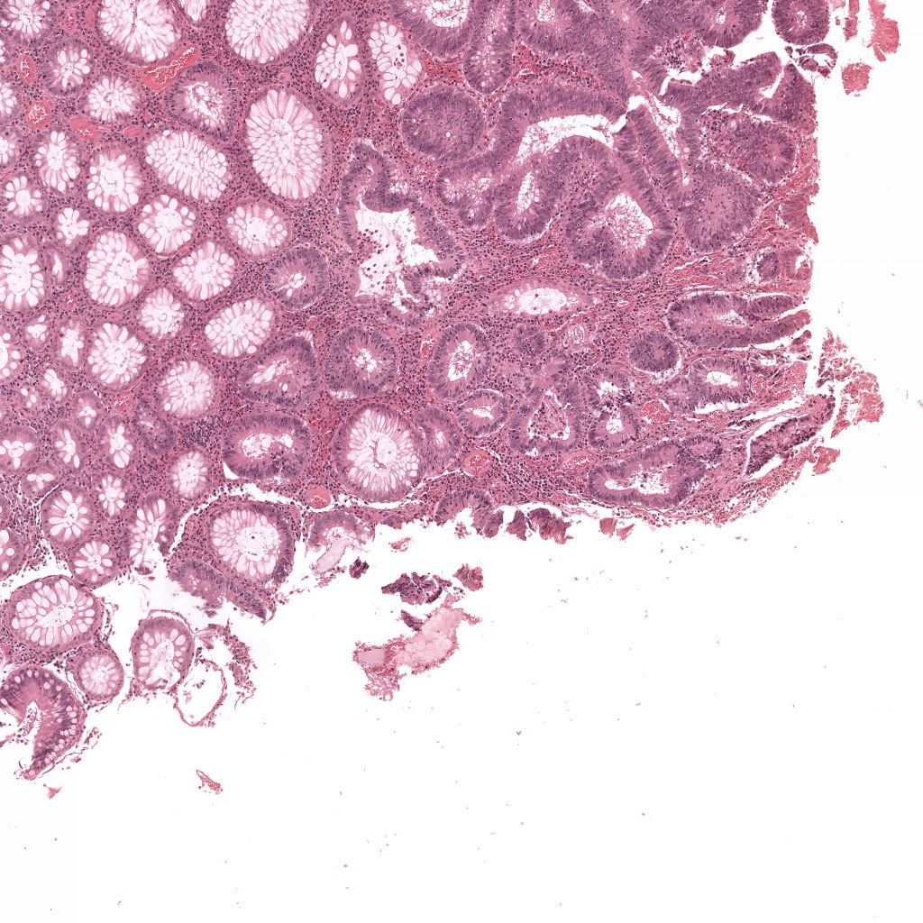
DL for high energy physics
Radboud
ML turbulence in weather models
Wageningen
Protein folding
Intel
biological interfaces from crystal artifacts in biomolecular complexes
Utrecht
ML for accelerating planetary dynamics in stellar clusters
Leiden
Multimodal analysis tools for histopathology clinical and research practice
RUMC

Slide 15
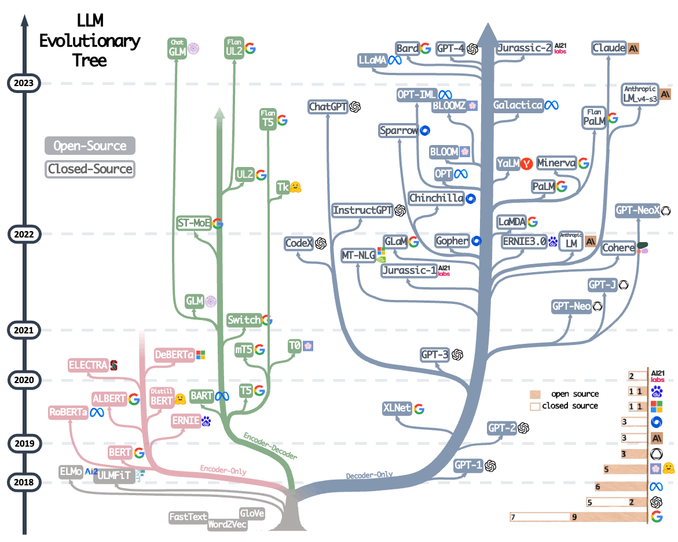
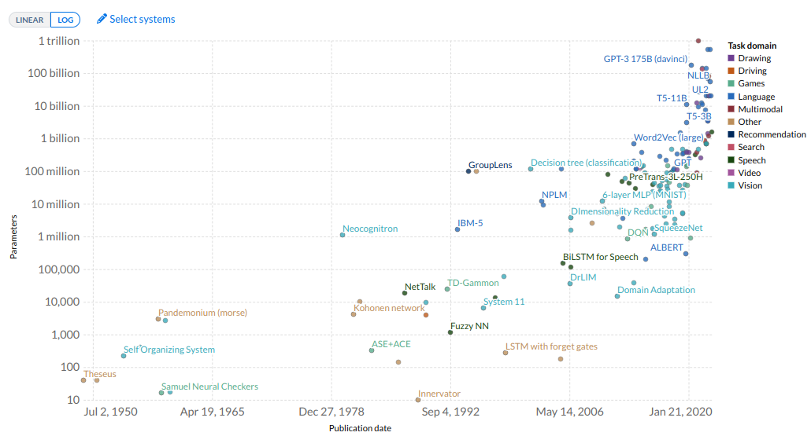
Cambrian Explosion of ML models

Slide 16
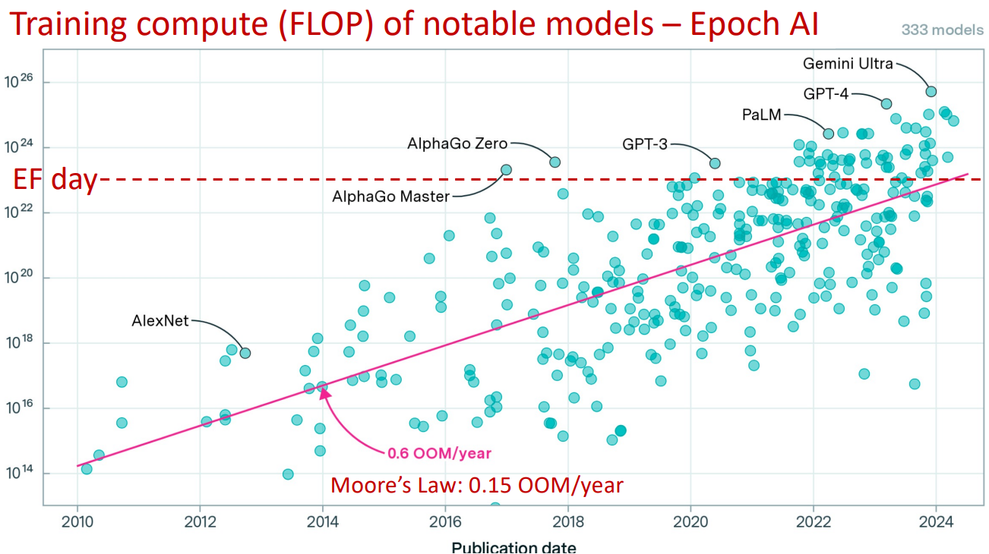
Growing Pace in OOM

Slide 17
Small or Large NWO Grant
2. Mail us!
https://www.surf.nl/en/research-it/apply-for-access-to-compute-services
https://servicedesk.surf.nl/wiki/pages/viewpage.action?pageId=30660193
https://servicedesk.surf.nl/wiki/display/WIKI/NWO+grants
bryan.cardenasguevara@surf.nl
damian.podareanu@surf.nl
matthieu.laneuville@surf.nl
hpml@surf.nl
https://www.surf.nl/en/consultancy-on-it-solutions-for-researchers
Apply for consultancy hours!

Slide 18
SURF 28/05/2023
Thank You!

